Slide 1
MAT 350 Engineering mathematics
Second order ODE with const. Coefficients.
Lecture: 4
Dr. M. Sahadet Hossain (MtH)
Professor
Department of Mathematics and Physics, NSU.

Slide 2


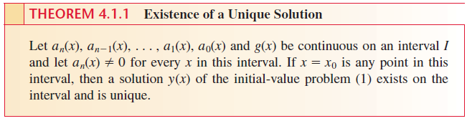
Higher Order linear differential equations:
For a linear differential equation an nth-order initial-value problem is
Solve-
(1)
Subject to

Slide 3

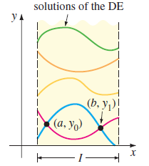
Boundary Value Problem (BVP)
(2)

Slide 4


Homogeneous ODE of n-th order:
(3)
Recall: Non-homogeneous ODE of n-th order:
6/ x² / e^{x}
Nonhomogeneous

Slide 5


Differential operator
The symbol D (for Differentiation) is called differential operator.
For higher order-

Slide 6
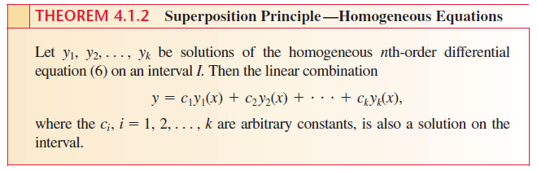
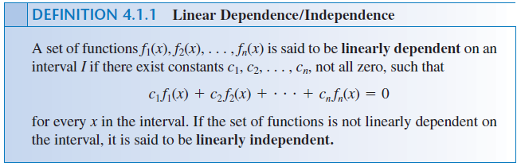

Slide 7
Homogeneous Linear ODEs of Second Order
Let us, consider (1) up to its second order derivatives,
Considering a₂(x)≠0,and divide both sides with a₂(x)
(4)
where a(x)=a₁(x)/a₂(x), b(x)=a₀(x)/a₂(x), and r(x)=g(x)/a₂(x).
A second-order ODE is called linear if it can be written
as (4), and nonlinear if it cannot be written in this form.
If r(x)=0, it is Homogeneous, if r(x) ≠ 0, it is Nonhomogeneous.

Slide 8




Homogeneous Linear ODEs of Second Order
Consider second-order homogeneous linear ODEs whose coefficients a and b are constant,
(5)
A trial solution of (5) can be considered of the form
(6)
Then,
Substituting into (5) gives,
Since the exponential is never zero for any real (and complex) λ,
Characteristic Equation.

Slide 9
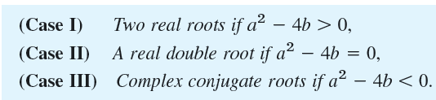
Homogeneous Linear ODEs of Second Order
(7)
Roots of the Chr. Eqn. (Auxiliary Equation) are:
Equation (7) has the roots of three different types.

Slide 10





Note:
and
called Basic solution of (7). Their linear Combination is called General Solution
The general solution is:
The general solution is:
The general solution is:

Slide 11





Example: Two distinct real roots:
Solution:
Roots are:
The general solution is:

Slide 12
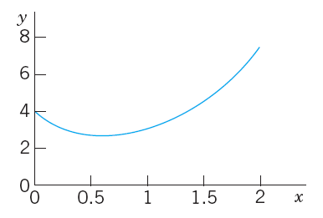
Figure shows that the curve begins at 4
with a negative slope ( -5 but note that the axes have different scales!), in agreement with the initial
conditions.

Slide 13





Example: Two same real roots
To apply the initial conditions, we need to evaluate

Slide 14
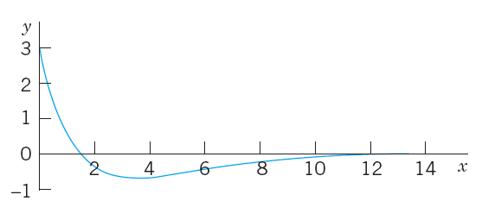
Graph starts at 3 of y-axis and the slope there is -3,

Slide 15


Example: Two complex roots:
Solution:
Chr. Equation is:
Solving we have two complex roots:
Hence, Gen. Sol. is:

Slide 16

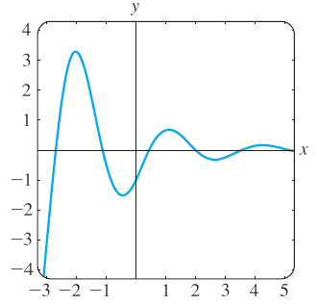
Example: Two complex roots:

Slide 17
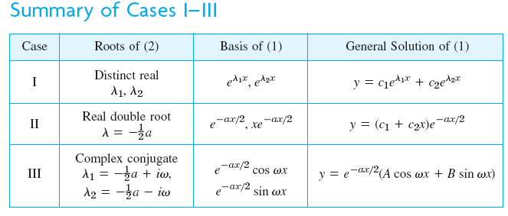

Slide 18



Slide 19



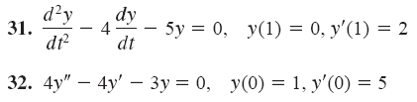
Exercise 4.3 (Zill 10th ed.)
Find the general solution of the given second-order differential equation.
Solve the given initial-value problem.
Solve the given boundary-value problem

